Slide 1
Pinpointing Performance Inefficiencies via Lightweight Variance Profiling
Pengfei Su
Shuyin Jiao
College of William and Mary
College of William and Mary
Milind Chabbi
Xu Liu
Scalable Machines Research
College of William and Mary

Slide 2


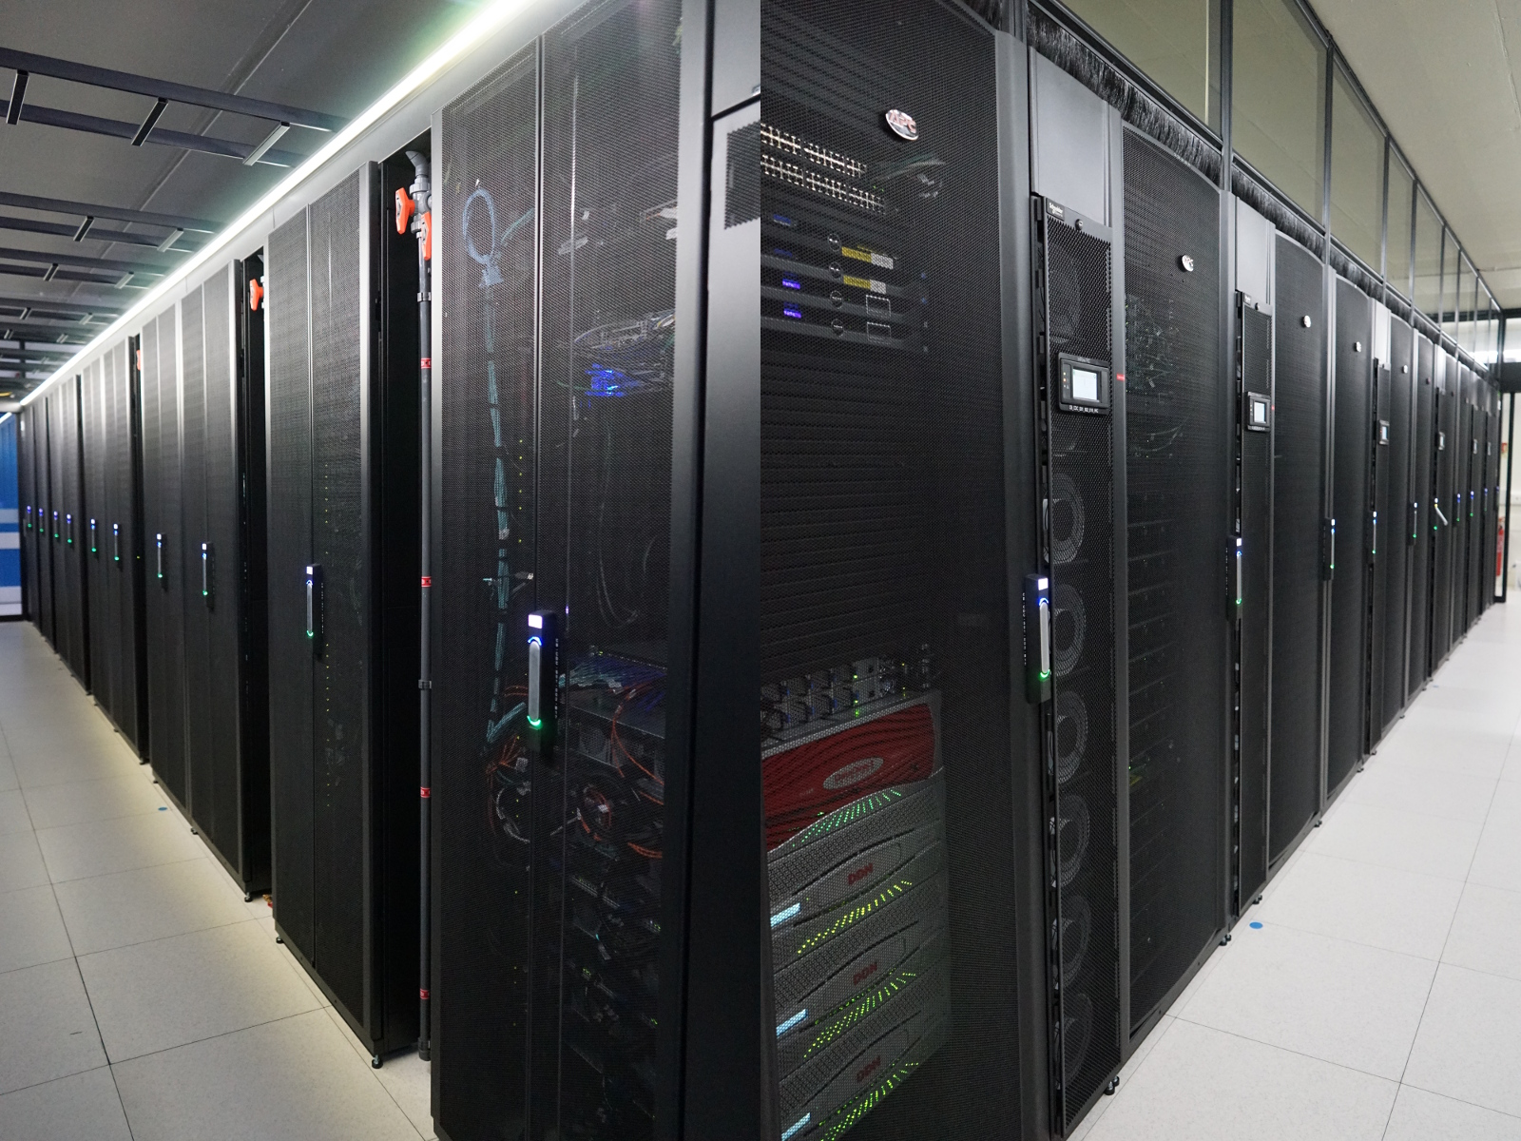
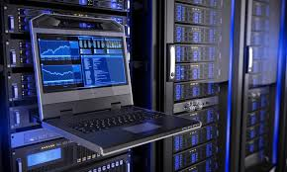
Complexity in HPC Software
Large amount of source code
Sophisticated control/data flow
Complexities
Hierarchies of component libs
Unpredictable hardware performance (cache, network)

Slide 3
The Landscape of Application Performance and Performance Tools
Fast
You are a genius, don’t waste your time in this session
Sometimes
Always
Listen to
the rest of
the talk
Use any performance tool
Slow
✘: Slow instances of a function are hidden due to averages
Variance detection can bubble up functions behaving erratically

Slide 4
Why Detect Variance
Detect performance anomalies
Especially in latency sensitive applications, e.g., “long tail” latency
Necessary for performance predictability
Especially in high performance applications using asynchrony
Avoid getting washed by averages
Proven technique in enterprise workloads
VProfiler [Huang et al. Eurosys’17]

Slide 5
Previous Focus vs. Our Focus
Previous focus
Variance of resource usage in MPI functions across different nodes
Rely on function-level instrumentation
Our focus
Variance of resource usage within a node across different invocations of the same function
Rely on sampling hardware performance monitoring units (PMU)

Slide 6
Motivating Example — GTC
Particle-in-cell code for simulations
Previous study[1]: traverse() introduce cache misses as program executes
Cache misses
i^{th} invocation of traverse()
[1] G Marin, G Jin, and J Mellor-Crummey. 2008. Managing locality in grand challenge applications: a case study of the gyrokinetic toroidal code. Journal of Physics: Conference Series 125 (jul 2008), 012087.

Slide 7

Motivating Example — GTC
Variance analysis
traverse() accesses particles sequentially: particle1->particle2->…
Optimization
Sort particles periodically
~20% speedup
Access order = storage order
Good data locality
Access:
Storage:
particle1 | particle2 | particle3 | particle4 | particle5 | particle6
…
Timeline
Access order $≠$ storage order
Loss of data locality
Access:
Storage:
particle1 | particle4 | particle2 | particle6 | particle5 | particle3

Slide 8
Function Variance Detection
Prerequisite
Place calipers at function entry and exit to identify function boundary
Measure the resource usage in a function
Function entry
main() {
funA();
}
Function exit
Measure resource usage: r1
main()
funA()
Resources consumed in funA() = r2 - r1
Measure resource usage: r2
Timeline

Slide 9
Function Variance Detection
Previous effort
Instrumentation-based tools
Instrument function entry and exit to identify function boundary
Function entry
main() {
funA();
}
Function exit
1st instrumentation point
main()
funA()
Resources consumed in funA()
2nd instrumentation point
✔️: high accuracy
✘: high overhead (~2x)
Timeline

Slide 10
Difficulty in Detecting Variance via Sampling
Sampling-based tools cannot synchronize sampling with function call and return from the same function instance
Function entry
sampling point
Function exit
funA()
sampling point
main()
sampling point
funA()
sampling point
✔️: low overhead
✘: low accuracy
Timeline

Slide 11
What Sampling Tools Need for Variance Detection
The ability to randomly sample function calls
But no instrumentation on function entry or exit
The ability to synchronize “start monitoring” with function call
The ability to synchronize “stop monitoring” with function return

Slide 12
FVSampler
A sampling-based function execution variance detection tool
Lightweight
6% (time)
7 MB/thread (memory)
Accurate
Synchronize sampling with function boundary to monitor whole function instances
Insightful
Provide full calling context to drilldown the call paths of high variance
Measure variance in various performance metrics, e.g., CPU cycles, cache misses, retired instructions

Slide 13
What Sampling Tools Need for Variance Profiling
︖
The ability to randomly sample function calls
But no instrumentation on function entry or exit
The ability to synchronize “start monitoring” with function call
The ability to synchronize “stop monitoring” with function return
︖

Slide 14
Performance Monitoring Units (PMUs)
Available in commodity CPU
Monitor hardware events
Can be configured to monitor function call events
Provide two modes
Counting mode: count # of occurrences of an event
Sampling mode: deliver a sample (interrupt) every N occurrences of an event

Slide 15
What Sampling Tools Need for Variance Profiling
✔️
The ability to randomly sample function calls
But no instrumentation on function entry or exit
The ability to synchronize “start monitoring” with function call
The ability to synchronize “stop monitoring” with function return
✔️
︖

Slide 16
Debug Register
Available in commodity CPU
Trap program execution when a designated address (watchpoint) is touched
Intercept function return

Slide 17
What Sampling Tools Need for Variance Profiling
✔️
The ability to randomly sample function calls
But no instrumentation on function entry or exit
The ability to synchronize “start monitoring” with function call
The ability to synchronize “stop monitoring” with function return
✔️
✔️

Slide 18
Methodology
Observation
main()
main() {
funA();
}
main()
Return
Call
funA()
funA()
Stack frame
…
Stack growth
Stack register
RSP
main()
Stack register
RSP
funA()
Stack register
RSP
Parameters
Read
Ret address
Ret instruction

Slide 19
Methodology
Synchronize sampling with function boundaries
Configure PMU to sample function call
Use a debug register to set a watchpoint at addr[RSP] to intercept function return
Function call
Function return
…
…
Stack growth
Stack growth
main()
main()
Parameters
Parameters
RSP
funA()
funA()
Ret address
Ret address
Ret address
Watchpoint trap
Ret address
Watchpoint
Read
Ret instruction

Slide 20
Methodology
Count resource usage of a function invocation instance
Read PMU to count resources (r1) used by the program at function call
Read PMU to count resources (r2) used by the program at function return
main() {
funA();
}
Function call
Function return
…
…
Stack growth
Stack growth
main()
main()
Parameters
Parameters
RSP
funA()
funA()
Ret address
Ret address
Ret address
Watchpoint
Watchpoint trap
Ret address
Read
Ret instruction
Resource usage in funA() = r2 - r1

Slide 21
Challenge
x86 CPU offers 4 debug registers
Limitation: monitor at most 4 functions simultaneously
Call chain: main()->funA()->funB()->funC()->funD()
main()
Watchpoint_{main}
funA()
Watchpoint_{funA}
funB()
Watchpoint_{funB}
funC()
Watchpoint_{funC}
funD()
No debugs!

Slide 22
Challenge
x86 CPU offers 4 debug registers
Solution: maintain a shadow stack to save active watchpoints
Require only 1 debug register
Shadow stack
main() {
funA();
}
…
main()
Watchpoint_{main}

Slide 23
Challenge
x86 CPU offers 4 debug registers
Solution: maintain a shadow stack to save active watchpoints
Require only 1 debug register
Shadow stack
main() {
funA();
}
…
main()
Watchpoint_{main}
main()
Return
funA()
Watchpoint_{funA}
funA()

Slide 24
Other Challenges in the Paper
Concurrently monitor multiple functions and recursions
setjmp()/longjmp()
Online variance calculation
Highlight variance of statistically significant functions
Calling context collection
Parallelism (multithreading/multiprocessing)

Slide 25
Experiments
Time overhead
1.06x

Slide 26
Experiments
Per-sample overhead
50 µs

Slide 27
Case Study
Program | Inefficiencies | Optimization | Speedup
Sequoia AMG2006 | Load imbalance | Reducing the granularity of parallel work | 1.08×
MASNUM | Linear search | Locality-friendly search | 1.54×
NERSC-8 MiniFE | Poor data structure | Replacing C++ set with unordered_set | 1.96×
Parsec-2.1 dedup | Poor hashing algorithm | Reducing hash collisions | 1.08x
Program | Inefficiencies | Optimization | Speedup
Sequoia AMG2006 | Load imbalance | Reducing the granularity of parallel work | 1.08×
MASNUM | Linear search | Locality-friendly search | 1.54×
NERSC-8 MiniFE | Poor data structure | Replacing C++ set with unordered_set | 1.96×
Parsec-2.1 dedup | Poor hashing algorithm | Reducing hash collisions | 1.08x

Slide 28
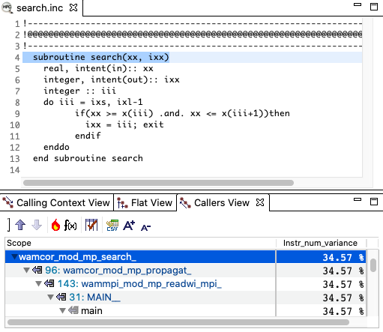
Case Study — MASNUM
Forecast ocean surface waves
ACM Gordon Bell Prize finalists
Function
Source code
Variance metric
Variance of instruction #
Calling context

Slide 29
Case Study — MASNUM
Variance of instructions # in different invocations of search()
# of instructions
i^{th} invocation of search()
Two takeaways:
1) # of instrs has a periodical distribution pattern
2) In each period, # of instrs (i.e., workload) in adjacent invocations are similar

Slide 30
Case Study — MASNUM
Investigation of search()
search() performs a linear search for each input over an array
Inputs in adjacent invocations are similar
input = {2, 2, 3, 3}
target array = {1, 2, 3, 4, 5}
✔️
1 | 2 | 3 | 4 | 5
search()
1 | 2 | 3 | 4 | 5
input = {2, 2, 3, 3}:
1 | 2 | 3 | 4 | 5
✔️
1 | 2 | 3 | 4 | 5
search()
1 | 2 | 3 | 4 | 5
input = {2, 2, 3, 3}:
1 | 2 | 3 | 4 | 5
✔️
1 | 2 | 3 | 4 | 5
search()
1 | 2 | 3 | 4 | 5
1 | 2 | 3 | 4 | 5
input = {2, 2, 3, 3}:
1 | 2 | 3 | 4 | 5
✔️
1 | 2 | 3 | 4 | 5
search()
1 | 2 | 3 | 4 | 5
1 | 2 | 3 | 4 | 5
input = {2, 2, 3, 3}:
1 | 2 | 3 | 4 | 5
# of comparisons in adjacent invocations are similar
# of instructions in adjacent invocations are similar

Slide 31
Case Study — MASNUM
Optimization
Locality-friendly search
Start from the location where the previous search finishes
Speedup: 54%
Variance: 35% -> 2%
# of instructions
# of instructions
i^{th} invocation of search()
i^{th} invocation of search()
(1) Variance before optimization
(2) Variance after optimization

Slide 32
Case Study — Parsec Decup
(1) Variance before optimization
i^{th} invocation of hashtable_search()
(2) Variance after optimization
i^{th} invocation of hashtable_search()

Slide 33
Conclusions
FVSampler
Pinpoints function execution variance with low overhead
Advances the state-of-the-art by demonstrating the ability to synchronize sampling with function boundary
Addresses challenges arising due to combining the usage of PMUs and debug registers
Provides rich insights to identify and optimize unpredictable code performance
Available at https://github.com/WitchTools/FVSampler
Questions?

